Slide 2
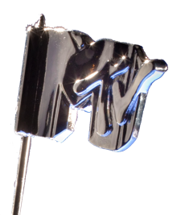
MTV OBJECTIVES
Drive tune-in for the Video Music Awards
Develop impactful and interactive experiences to attract and engage users
Create a socialized experience online
Create video sampling opportunities
ZIMBIO STRATEGY
All eyes will be on Brooklyn and the MTV VMA’s with Zimbio’s highly customized Brooklyn's Freshest Program. With “fresh” as the filter, editorial integrations and first-to-market rich media experiences will bring the creative culture, spirit and attitude of Brooklyn to life while building excitement for the 2013 MTV VMAs and its discovery of the next best thing among our massive audience of pop culture and music fans.

Slide 3
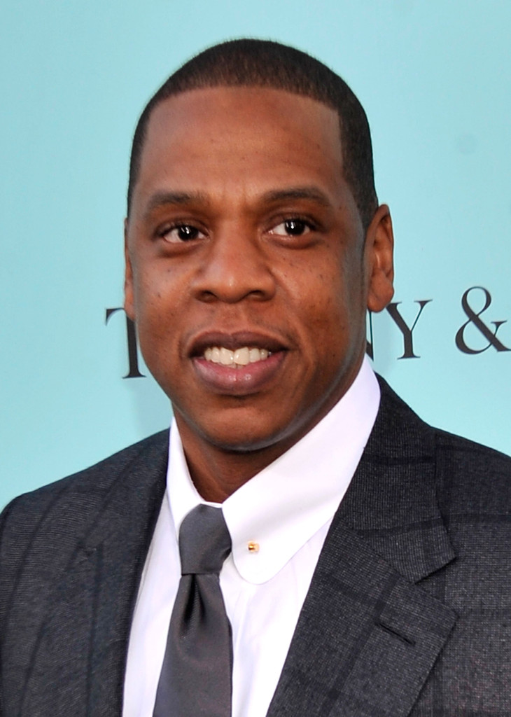
BROOKLYN’S FRESHEST
CUSTOM PROGRAM
Brooklyn’s Freshest Program Elements:
Custom Section – Co-branded Zimbio section devoted to the VMAs and the Brooklyn connection
Custom Editorial Series - Brooklyn Music Scene and MTV Video Music Awards Content
Custom Social Integration – Custom Instagram Feed
High Impact Brand Experiences – Livingly produced high-profile experiences, featuring:
Zimbio-MTV VMAs Logo Stunt – Custom “Moonman” inspired Zimbio site logo on the day of the Awards
Brooklyn-Inspired Video Wall Takeover with Site Reveal
Countdown to the MTV VMAs Super Header Takeover
Timing: August 12th to 25th

Slide 4
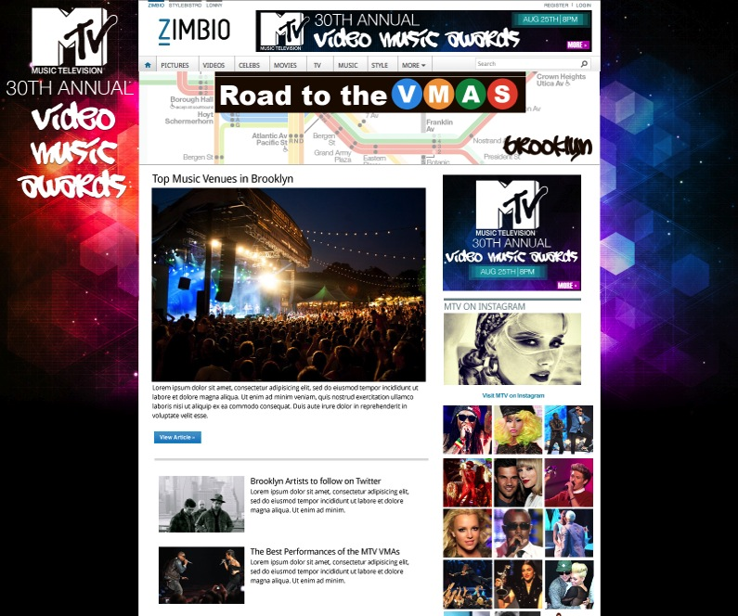
BROOKLYN’S FRESHEST CUSTOM SECTION
The Brooklyn’s Freshest Program will build excitement and tune-in for the VMAs among Zimbio readers through a VMAs and Brooklyn-Inspired Custom Section that highlights VMA’s discovery of fresh talent alongside the borough’s music scene, past, present, and future.
DETAILS:
Brooklyn’s Freshest Custom Section:
One stop destination uncovering the past, present and future of Brooklyn music such as:
Historical events to newest venues “Freshest” bands with Brooklyn roots and the ones that made it big
Songs about Brooklyn
Brooklyn neighborhood tours
Custom VMA edit series (see next pg)
Custom Social Integration
Sponsorship details:
100%SOV - Skin, Leaderboard, and M-Rec
Co-branded custom header
Co-branded promotions:
Custom Theme Stream Unit
Editorial homepage and social posts

Slide 5
BROOKLYN’S FRESHEST CUSTOM EDITORIAL SERIES
For the Brooklyn’s Freshest Program, the Zimbio edit team will create anticipation for this year’s event via a series of custom articles and content experiences highlighting both the cultural impact of the Video Music Awards and the world of Brooklyn-based music.
DETAILS:
Brooklyn’s Freshest Custom Edit Series*:
VMAs: Past, Present, and Future – Articles and photo specials highlighting the “best of” moments from past VMAs, the lineup for this year’s event, and the fresh artists we can expect for future editions
#RoadtotheVMA’s Map of Brooklyn’s Music Scene – An interactive map highlighting the venues, hang outs, and historic landmarks that have forged the Brooklyn music scene
Games and Polls – We will let our readers decide both best of VMAs moments and Brooklyn’s freshest talent
*Concepts subject to final editorial approval

Slide 6
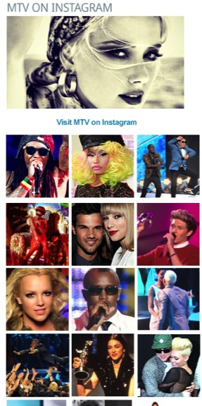
BROOKLYN’S FRESHEST CUSTOM SOCIAL INTEGRATION
The Brooklyn’s Freshest Program will build additional reader engagement and excitement for the show by bringing some VMA and Brooklyn-Inspired images to the walls of Zimbio via the visual and collaborative power of Instagram.
DETAILS:
Brooklyn’s Freshest Custom Social Integration:
Custom Instagram feed module fixed on Zimbio custom section (8/12-25) and homepage (8/25)
Feed will be custom curated based on relevant hash tags to include the best VMA and Brooklyn music images
The Zimbio staff will kick start the feed by shooting popular musical, street art, and cultural landmarks throughout Brooklyn
Zimbio readers will be encouraged to Instagram their own VMA and Brooklyn-Inspired image using a custom hash tag

Slide 7
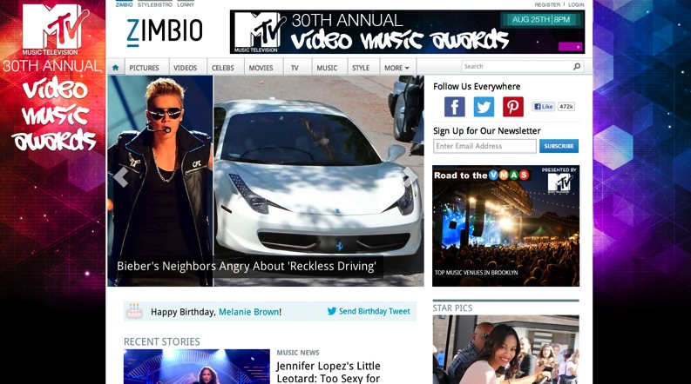
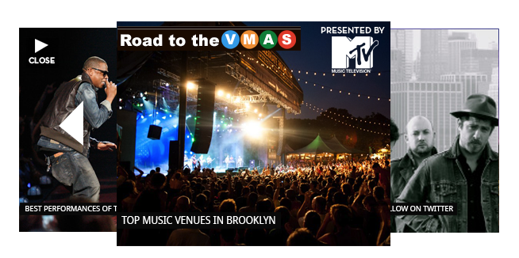
BROOKLYN’S FRESHEST THEME STREAM
Brooklyn’s Freshest custom content pages will gain additional promotion and visits through our co-branded Theme Stream traffic driving solution.
DETAILS:
300x250 expands on rollover to display a navigable gallery of “Brooklyn’s Freshest” stories and content
Each “Brooklyn’s Freshest” story within the Theme Stream is set to click through to the relevant content page
Unit will be updated throughout the campaign to promote a variety of “Brooklyn’s Freshest” content
Clickable logo will drive traffic to the MTV VMAs web page

Slide 8
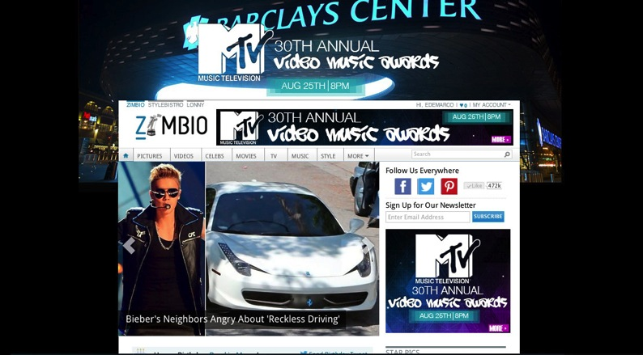
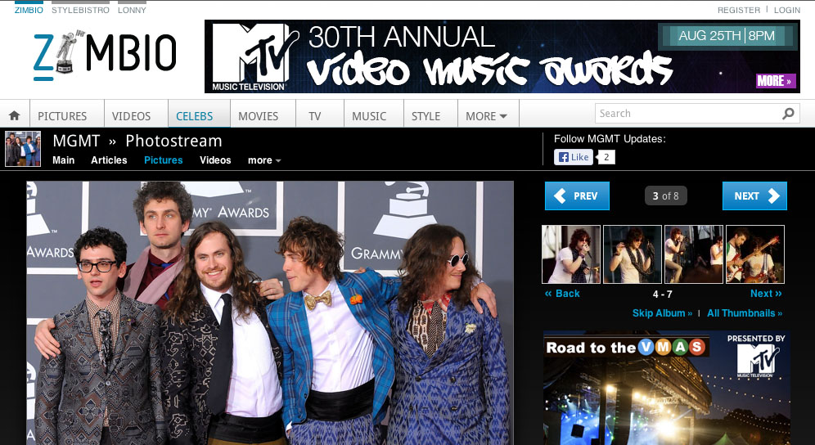
ZIMBIO MTV VIDEO MUSIC AWARDS LOGO STUNT
The Brooklyn’s Freshest Program will gain additional attention among our music and entertainment minded readers via a one-of-a-kind custom MTV VMAs inspired treatment of the Zimbio logo on day of the event.
DETAILS:
Custom logo will feature MTV VMAs graphics in place of Zimbio lettering
Custom logo will run for the entire day of the event (8/25) across every page of the site

Slide 9
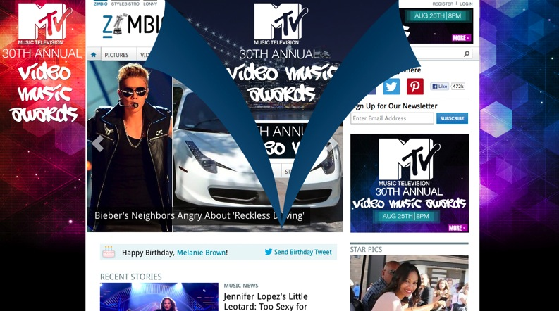
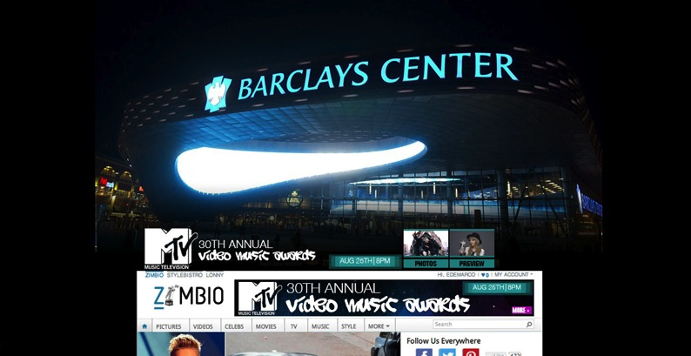
BROOKLYN-INSPIRED VIDEO WALL TAKEOVER W/ SITE REVEAL
The Brooklyn’s Freshest Program will include a high profile Video Wall Takeover, featuring a first-to-market Site Reveal experience, to help make the MTV Video Music Awards announcement impossible to miss.
DETAILS:
Site Reveal overlay will display on page load and automatically give way to reveal the Video Wall Takeover experience
The Video Wall unit will display a brief teaser video at the top of the page to generate interest in the VMAs
When engaged, the Video Wall player will push down the entire page to display (up to 3) large format videos
The Video Wall will be paired with both the in-page Leaderboard and M-rec to create a 100% SOV Takeover

Slide 10
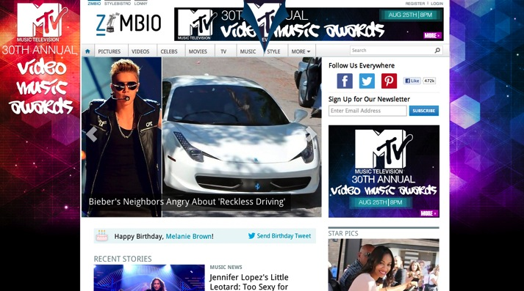
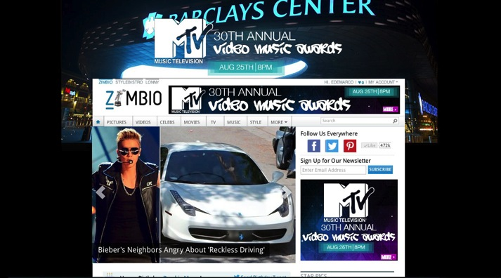
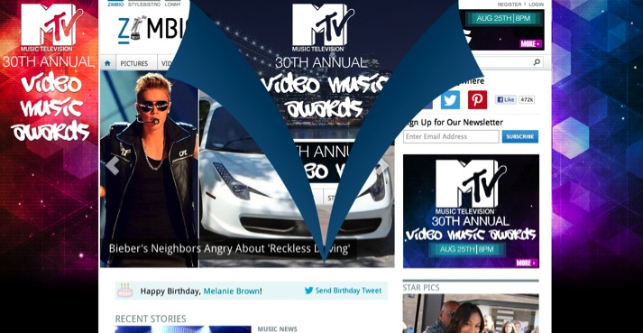
BROOKLYN-INSPIRED VIDEO WALL TAKEOVER W/ SITE REVEAL
Initial State
Teaser Video State
Animation Reveals MTV Video Teaser
Full Video Wall State (Expands on Click)

Slide 11
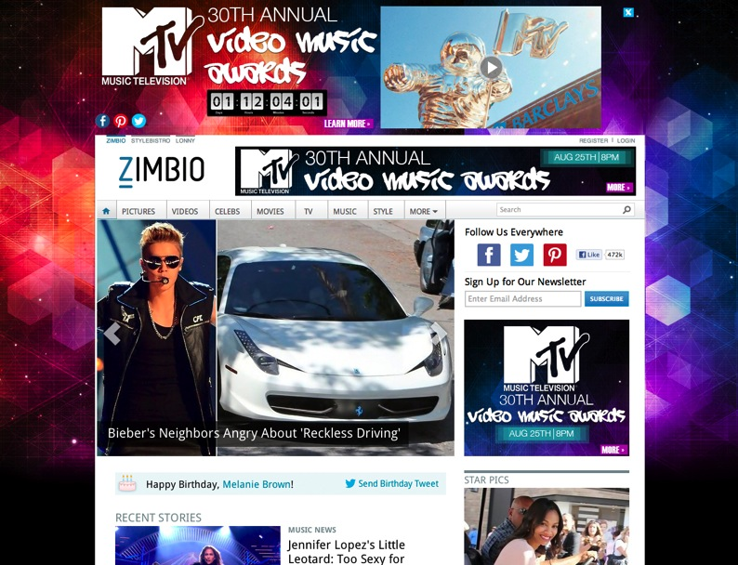
COUNTDOWN TO THE MTV VMAs SUPERHEADER TAKEOVER
The Brooklyn’s Freshest Program will include a high profile Super Header Takeover, featuring a countdown clock, to help amplify the urgency of MTV Video Music Awards messaging in the run up to the show.
DETAILS:
The Super Header Takeover will drive awareness for the show via MTV VMA promo video
The Super Header unit will include a countdown clock in order to emphasize the event is coming very soon
The Super Header will be paired with custom page skins and both the in-page Leaderboard and M-rec to create a 100% SOV Takeover

Slide 12
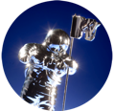
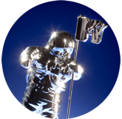
BROOKLYN’S FRESHEST CUSTOM PROGRAM SUMMARY
 | BROOKLYN’S FRESHEST SPONSORSHIP |  |  |  | HIGH IMPACT BRAND EXPERIENCES
 | Custom Section | Custom Editorial Series | Custom Social Integration | Theme Stream Traffic Driving Unit | Zimbio-MTV VMAs Logo Stunt | Video Wall Takeover w/ Site Reveal | Countdown to the VMAs Super Header Takeover
Commitment Levels
$50K
$100K
Please see media plan for detailed breakouts of timing, inventory, and budget elements.

Slide 13
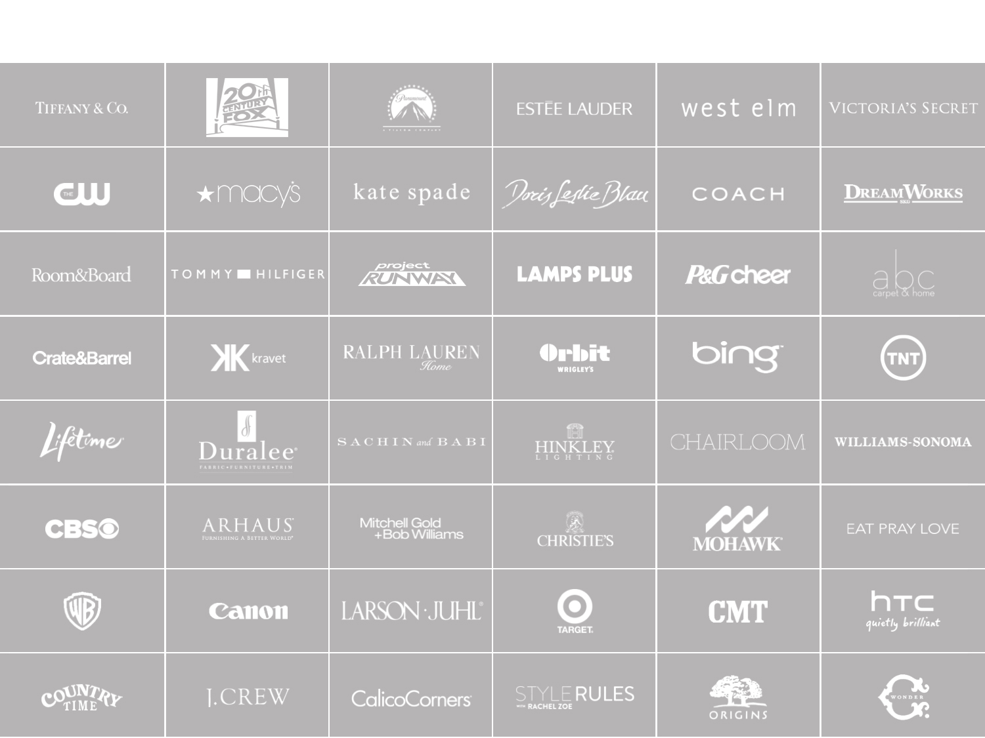
COMPANY YOU KEEP

Slide 14
John Newlin
john@livingly
(415) 999-4141

